Slide 1

Autism Hackathon Use Case 3: Machine Learning
Presented by:
Noha Elprince, Olive Kingsley, Hanen Bondka, Anita Mohanani Rishi Bhatnagar, Dhruv Bhatnagar, Peter Shand, Halaa Menasy, Adam Pryce, and Ryan Carpenter
SME:
Richard M. Kubina and Nate Green

Slide 2

AGENDA
Problem Statement
Approaches
Insights
Executive Summary
Next Steps
Appendix: Dimensionality reduction techniques:
PCA
T-SNE (visualization)
Clustering Model
Clustering Analysis

Slide 3
Problem Statements
Problem Statement #1 - Identify peer group for a patient to compare progress against
Problem Statement #2 - Determine whether progress is being made based on assessment

Slide 4
Methodology
Visualization of different patterns
Dataset
t-SNE
Cluster Model (K-Means, GMM)
Important cluster variables
PCA
Cluster profiling
Principal component analysis (PCA) is used to reduce the dimensionality. It finds a new set of dimensions such that all the dimensions ranked according to the variance of data along them.
t-SNE is used to reduce the dimensionality, data visualization and for outlier detection. It is used to map high dimensional data to 2 or 3 dimensions in order to visualize it.
Cluster Labelling
insights

Slide 5
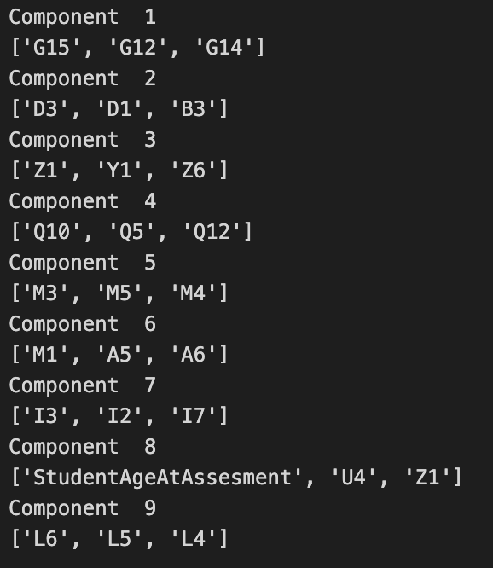
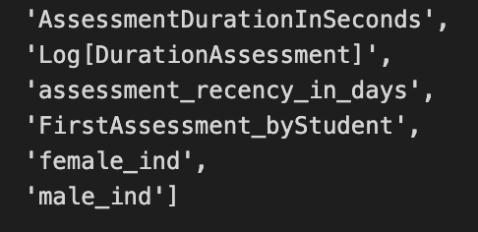
PCA
Feature selection was based on the most important features in the dataset with the highest variance sorted descending based on the absolute value PCA loadings
Total explained variance of those top features = 60%
Added features

Slide 6
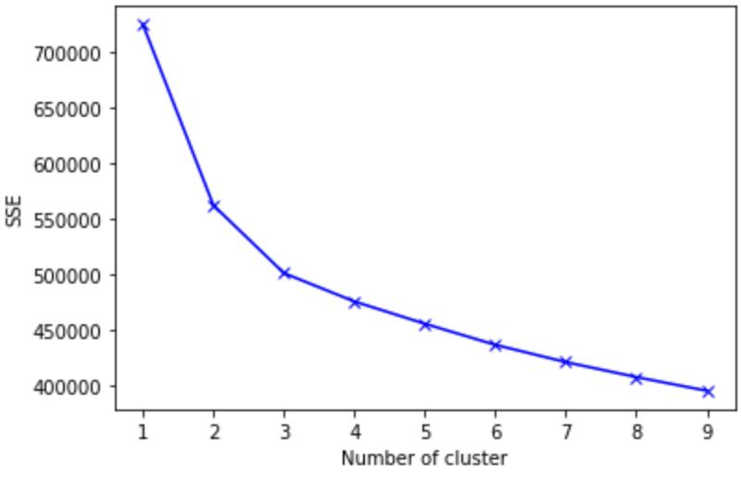
K-Means Cluster Model
Dataset dimensions are 23,354 rows and 32 columns
Quality issue appeared with the Assessment date, so we needed to drop the “assessment_receny_in_days” feature
Silhouette score for 3 clusters =0.15
Cluster label | counts
0 | 9932
1 | 6718
2 | 6704

Slide 7
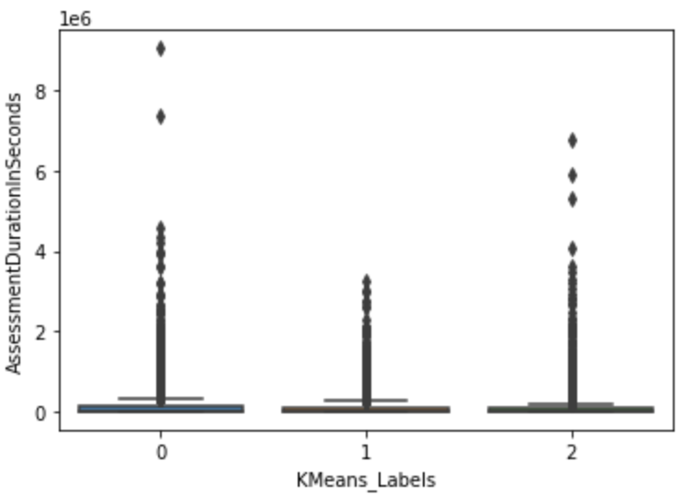
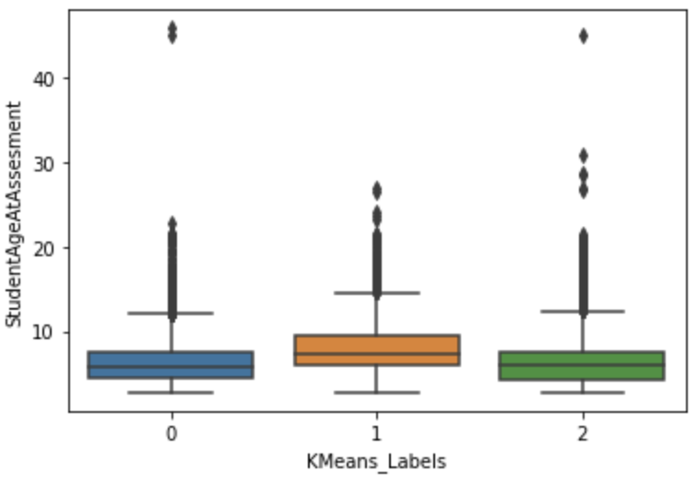
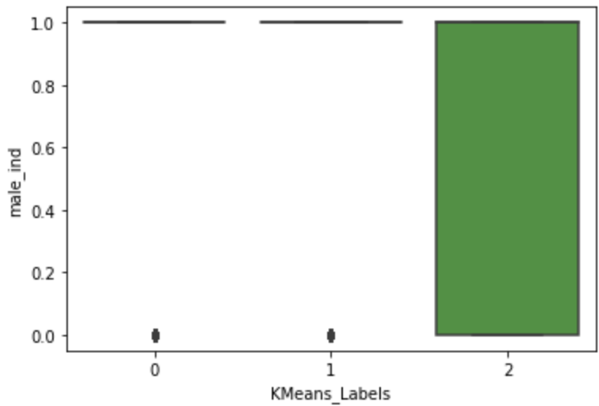
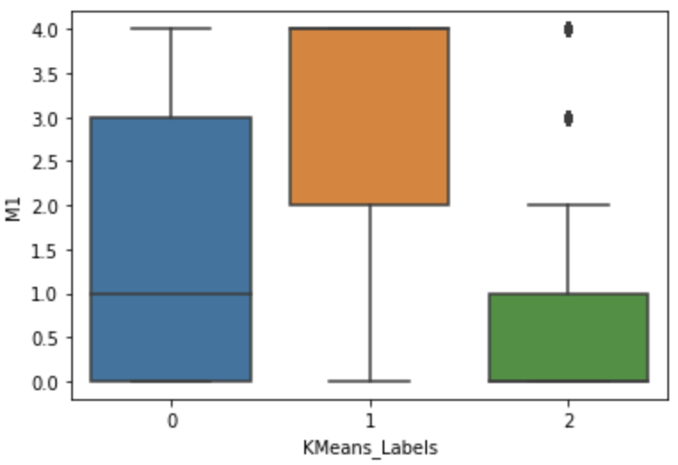
Cluster Analysis and labelling
Cluster 0 and 2 takes more time to complete the assessment
Older kids with Autism are in cluster 0 and 2 which takes more time to complete the task than cluster 1
Males mainly are concentrated in cluster 2
For assessment M1, cluster 1 median outperforms
other clusters in ratings, followed by cluster 0 then 2

Slide 8
Insights
Data curation
Data cleaning - e.g., future dated assessments, date of births, missing gender, etc.
Data compaction – from 544 skills to 25 behaviors – unweighted means, weighted means, bucketing
Selecting the right model
Tried K-means, GMM
Data analysis
Lean metadata – age, gender are very broad dimensions to profile
Visualizing the data
https://jolly-desert-01b5c5610.3.azurestaticapps.net/

Slide 9
Next Steps
Depth vs breadth of data
Quality of data collection
Predictive model instead of only cluster analysis
More metadata
Data accuracy
Capture videos and overlap with video analysis

Slide 10

Appendix: PCA

Slide 11
How PCA reduces dimensions of the data?
Remove redundancy + Keep the most important information
I. Keep the most important info. we want the data to be spread out across each dimension (maximize variance)
II. Remove Redundancy
we want the dimensions to be independent

Slide 12
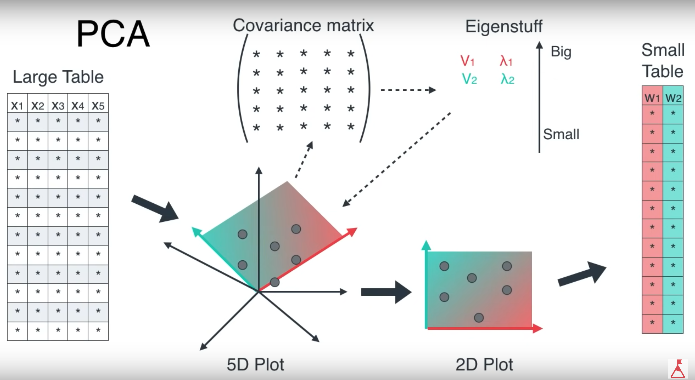


How does PCA works?
Calculate the covariance matrix X of data points.
Calculate eigen vectors and corresponding eigen values.
Sort the eigen vectors according to their eigen values in decreasing order.
Choose first k eigen vectors and that will be the new k dimensions.
Transform the original n dimensional data points into k dimensions.
K=2, n=12, m=5
,

Slide 13
Appendix: T-SNE

Slide 14
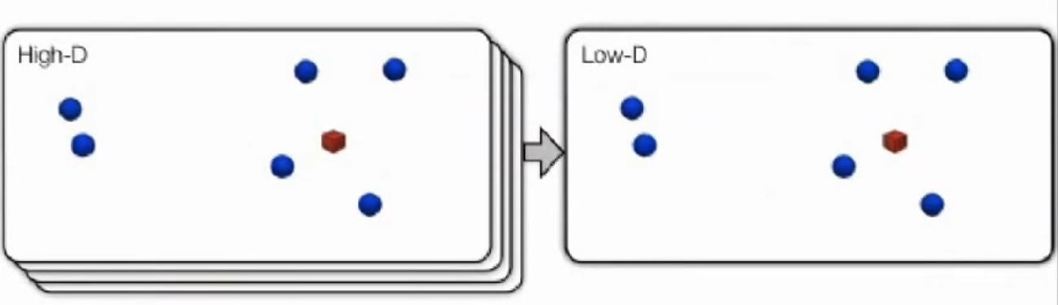
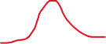
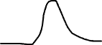
What is T-SNE? t-Distributed Stochastic Neighbor Embedding
Student T-Distribution
z
z’
y
y’
x
x’
The similarity of datapoint x to datapoint y is defined as the conditional probability, p(y|x), that x would pick y as its neighbor if neighbors were picked in proportion to their probability density under a Gaussian centered at x
Minimize objective function Kullback Leibler Divergence (KL) that measures the discrepancy between similarities in the original data and similarities in the map using Gradient Descent => help preserves local structure
Check this video for more info about KL:
https://www.youtube.com/watch?v=xjKm4BcwqX8

Slide 15
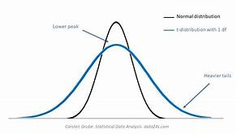
How t-SNE works?
Uses student-T distribution kernel (with 1df) instead of Gaussian kernel
Since it has more heavy/fatter tails than Gaussian which allow dissimilar points to be mapped too far apart in the low dimensional data => high variability in the data. This reduces the crowding problem.
Reduced the computation complexity (easier in derivatives computation)
In the computation of t-SNE, a parameter is called ‘perplexity’, which can be interpreted as a smooth measure of the effective number of neighbors, whose typical value is between 5 and 50.

Slide 16
T-SNE VS PCA
Metrics | PCA | T-SNE
Year of release | 1933 | 2008
Type of dim. reduction | Linear | Non-Linear
How it works | maximize variance (minimize squared error between distances in the original data and distances in the low dimensional data) | calculates a similarity measure between pairs of instances in the high dimensional space and in the low dimensional space. It then tries to minimize these two similarity measures using a cost function(Kullback-Liebler divergence) using Gradient Descent
Goal | Preserves large pairwise (global) distances | Preserves small pairwise distances (local similarities)
Visualization quality for complex high dimensional data | Poor (square error preserves only large distances) | Excellent (Usually show clear separation in the data)

